Slide 1
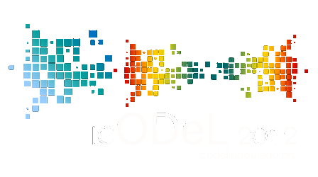
Intercultural understanding among Asian participants in a blended e-learning course

Slide 2
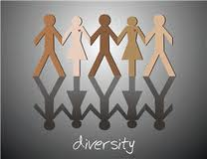
Geetha Udayangani Kulasekara The Open University of Sri Lanka Sherlyne A. Almonte-Acosta St. Paul University, Q. C. Philippines Uranchimeg Tudevdagva Mongolian University of Science and Technology

Slide 3
Content
Introduction
Research Problem
Method
Result and Discussion
Conclusion

Slide 4
Introduction
Expansion of technology and global mobility
Cultural diversity/multiculturalism
Challenges in an e-learning environment

Slide 5
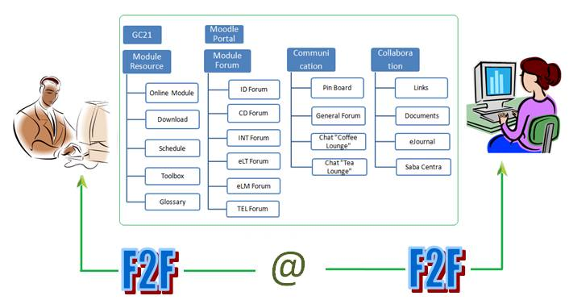
Structure of the eLDI course and tools used for communication

Slide 6
Research Problem
How does intercultural understanding manifested in the online and face to face interactions between and among learners and tutors?
How do participants adjust and consider the so called intercultural understanding in the varied aspects of interactions?
What are the factors of intercultural understanding that were evident in the process?

Slide 7
Case Study
Interview
Observation
Documents

Slide 8
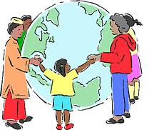
Result and Discussion
Theme 1: Difference as a springboard to meaningful interaction
Theme 2: Understanding before Judgment
Theme 3: Developing an atmosphere of camaraderie

Slide 9
Conclusion
Intercultural understanding is made possible through the supportive and welcoming learning environment in eLDI Asia, 2011
Supportive and welcoming environment was manifested in the entire course, in particular within the first face to face session.
Along with the dynamics of Intercultural understanding is the emotive and imaginative memories brought by the first face to face session. Therefore, face to face session contributed to a successful intercultural understanding within the e-learning class.

Slide 10
Intercultural understanding refers to the dynamics of the openness and willingness to adjust to the other beliefs, culture, backgrounds, ideas, concept of self, values, attitudes, and behavior. Hence, respect, broadmindedness, and responsibility with and among participants are practiced. The dynamics were susceptible to negotiation with the aim of maintaining healthy camaraderie.

Slide 11
Respect
Broadmindedness
Responsibility
openness
values
Intercultural
Understanding
willingness
culture
negotiation
adjustment
attitudes
beliefs
behavior
ideas
concept of self

Slide 12
Thank you

